Slide 1
Mood food
Bringing you food…based on your mood

Slide 2
(insert screenshot of app here)

Slide 3
What is mood food?
Mood Food brings you food options nearest you based on your mood!
You simply type in your current mood, and we provide a food option closest to your zip code.
Don’t like the choice we gave you? That’s okay – we’ll give you five more choices.

Slide 4
Development process
Front-End Team:
Anna and Justin
Process included:
- Wireframing
- Mockup
Back-End Team:
Chelsey and Simeon
Process included:
- Google Places API
- IBM Watson API

Slide 5
Behind the scenes
What was our thinking behind the development of this app?
We wanted something simple, sleek, and user-friendly.
This app is based on our own personal experiences having difficulty choosing what to eat, or at a loss for what to eat because there are too many choices.
Too many choices = not good. That’s why you get one option at a time, with a max of five choices.
You can always enter a new mood to see what else we can recommend!
Parameters:
Distance of restaurant from user: 10 mile radius
Ratings of 3 or greater.
Food categories based on emotion

Slide 6
Technologies used
Front-End:
HTML
CSS
Bootstrap
(insert anything else here)
Back-End:
JavaScript
jQuery
Google Places API
IBM Watson Technology: Sentiment and Emotion Tracker using Natural Language Understanding
(insert other tech used here)

Slide 7
Demo time
Check it out:
https://chelseymarie6.github.io/moodfood/

Slide 8
Potential/future development
The sky is the limit with IBM Watson technology…so what does that have to do with food again?
Voice-input is the next step in the development of this application.
Currently, we are asking a text input from the user for their mood. With future development, our application has the potential to interpolate a user’s emotion based on voice-input and then provide a food suggestion.
Additional factors beyond the parameters we selected (categorical style food selection, ratings, and location) could include:
User login/profile to keep track of their moods and food choices to ensure dynamic recommendations are being made
Integration with other apps such as a user’s calendar to plan ahead for meals
Could incorporate recipes, and/or grocery services beyond providing restaurant choices

Slide 9
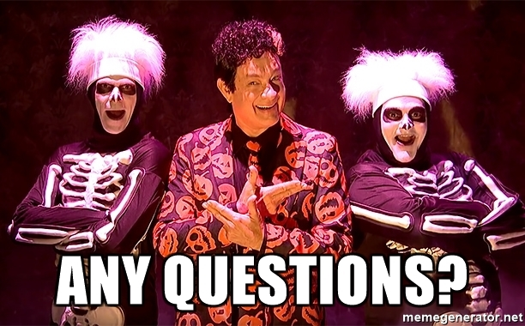
Q&A

